Slide 1
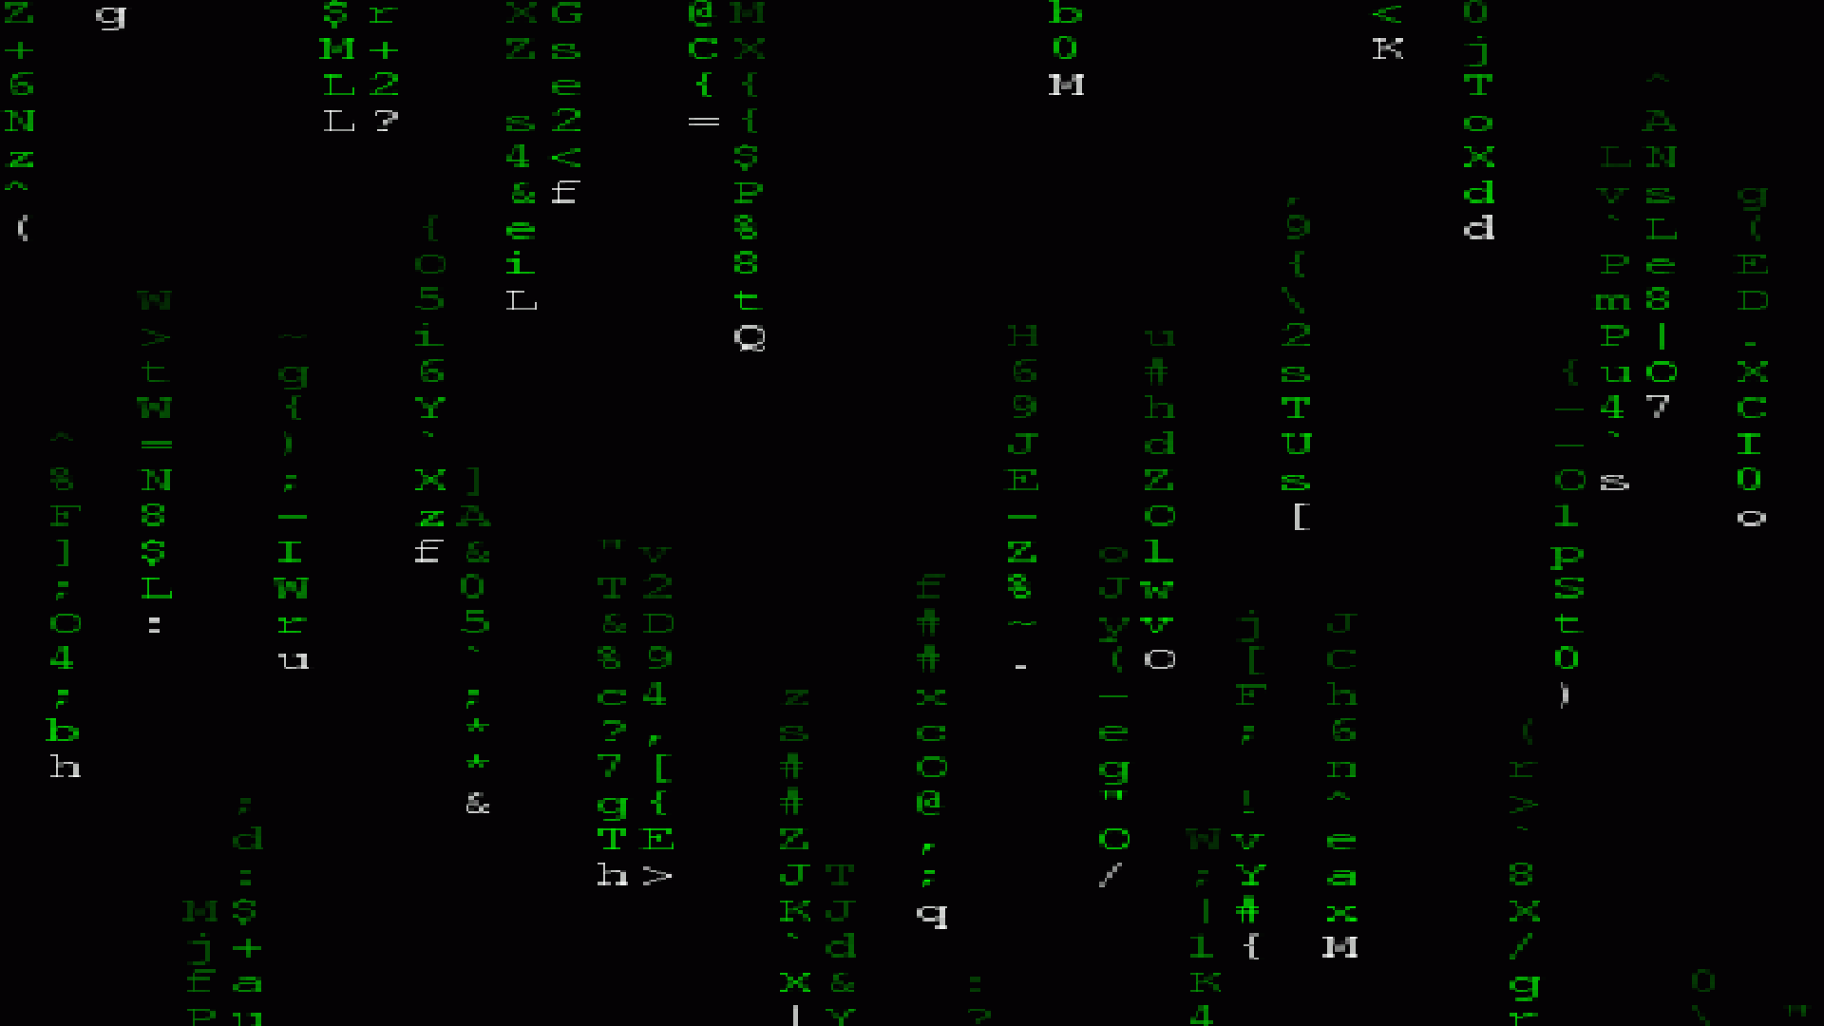

Introduction to Computational Biology
Lecture 0
BIOL 4360, BIOL 5360, MARB 6360
Dr. Chris Bird

Slide 2
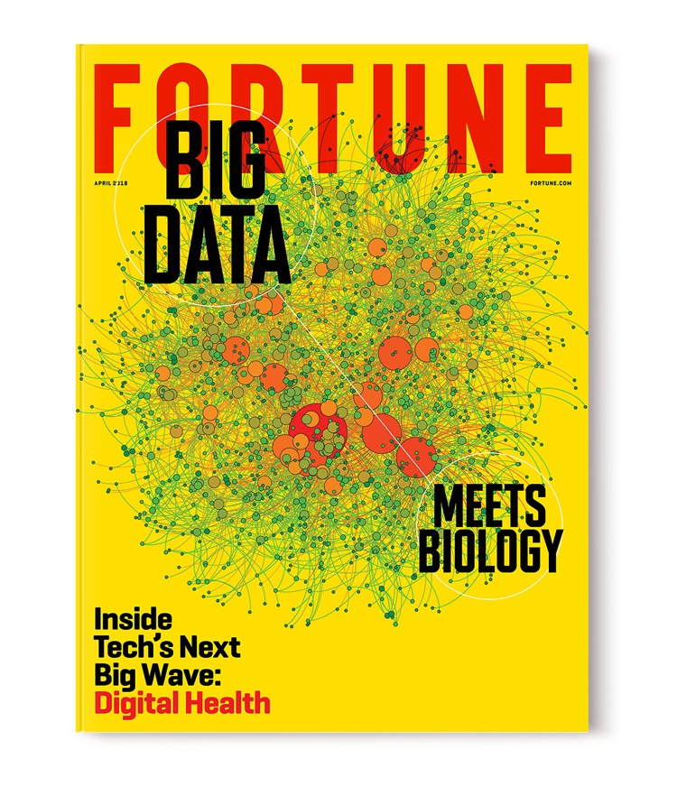
Why are computational skills important for biologists?
Increasing data size and complexity
Increasing sophistication of statistical and mathematical analyses
Transparency, reproducibility, and documentation

Slide 3
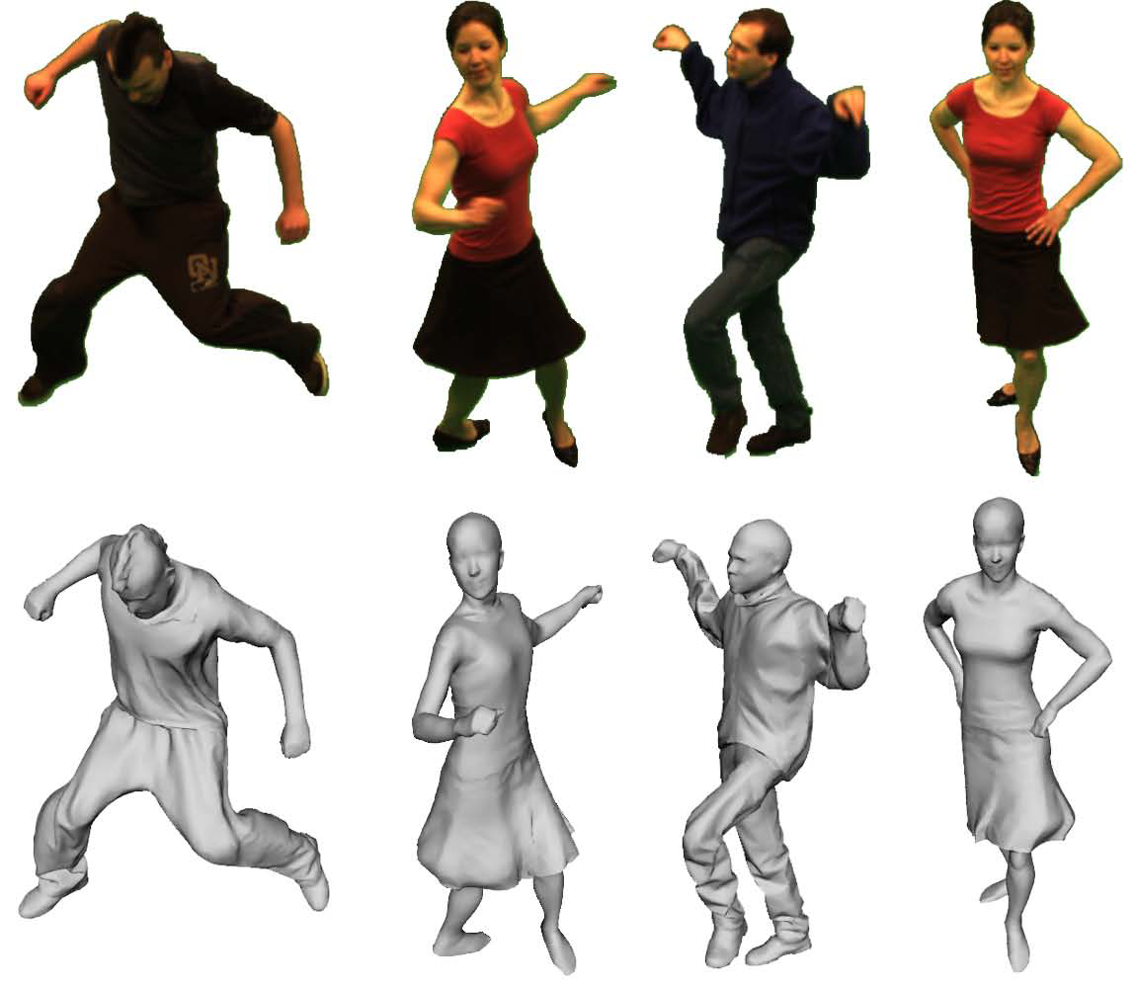
Why should biologists be interested in developing computational kung-fu?
Automate impossibly tedious, monotonous, and lengthy tasks
Increased rate and significance of discovery
Career success
Maximize potential

Slide 4

Why did I choose to develop this course?
Lack of (introductory) computational courses for biologists
Steep learning curve
The days of easily succeeding in biological research without computational knowledge and skill are over

Slide 5

If you so choose, I will show you the philosophy of data science
Automation
Interconnection
Modularity
Reproducibility
Organization
Comprehension
Openness
Simplicity
Correctness

Slide 6
Philosophy of Data Science
All data is digitized and stored in files
Data manipulations and analyses are documented in computer scripts that interface with data files and require no additional human intervention to complete analysis
Data & scripts are published with the report and openly accessible to all
Data Files
Publications & Reports
Computer Scripts

Slide 7
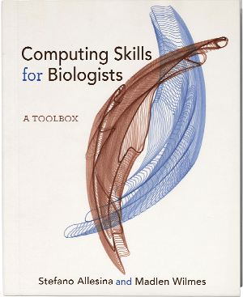
We Used to Follow The CSB Text Book, It’s a Good Resource But Not Required
Provides you with requisite breadth of tools at the expense of depth
Showcase of Linux, Python, R
Organized into 10 chapters, theoretically 1 per lecture
Goal is to flatten your learning curve
https://computingskillsforbiologists.com/

Slide 8
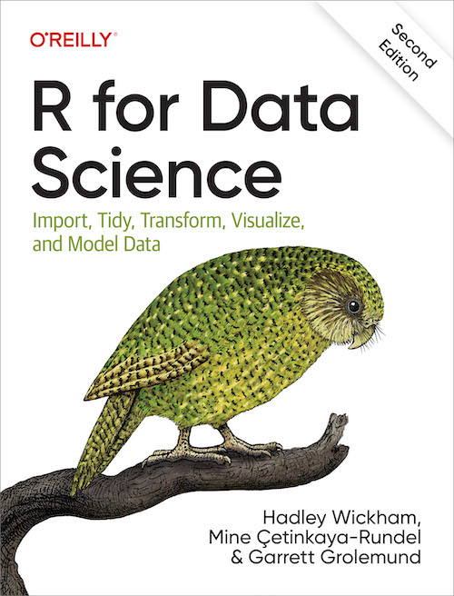
We are Going to Learn How to Use R
You will learn core principles of R that aren’t taught in other courses that expect you to use R
You will learn to use `tidyverse`, which was masterminded by the Author of the R for Data Science book, which is free.
https://r4ds.hadley.nz/

Slide 9
Learning Objectives
Recognize, describe, and organize data into standard biological data structures
Locate scientific data repositories and extract data
Operate UNIX/LINUX computers from command line
Construct and modify computer programming/scripting logic structures for processing biological data
Use version control software (git)
Describe and use regular expressions to query data
Typeset with LaTeX or MarkDown
Use the most popular open-source tools for biological data manipulation
Shell scripting (bash)
Scientific computing (python)
Statistical computing (R)
Tool repositories

Slide 10
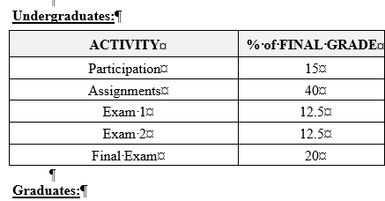
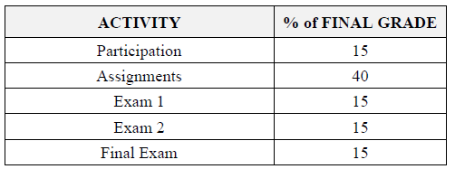
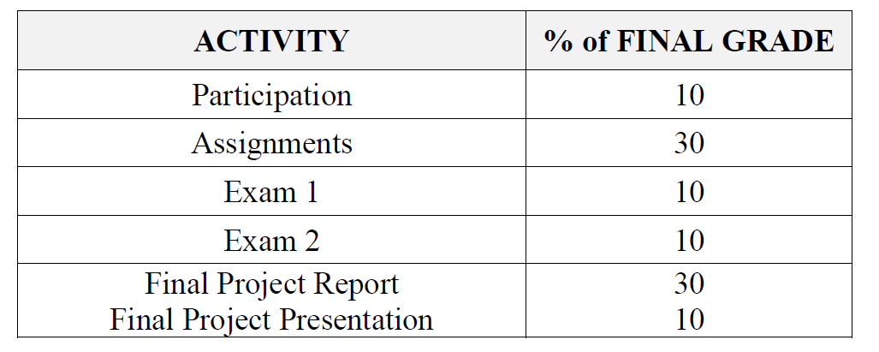
Syllabus & Course Organization
Syllabus is on blackboard and github
3 Parts of Course
Linux, R, Python
Additional skills
Version control with git
Typesetting with LaTeX, markdown

Slide 11
Lectures
Environment for you to learn new concepts
Hands-on with computers
Power-point & GitHub driven
On zoom
Independent exercises w/ MS Forms linked in GitHub
Note: I update the course materials prior to each lecture.
Don’t go ahead of where we are in the class

Slide 12
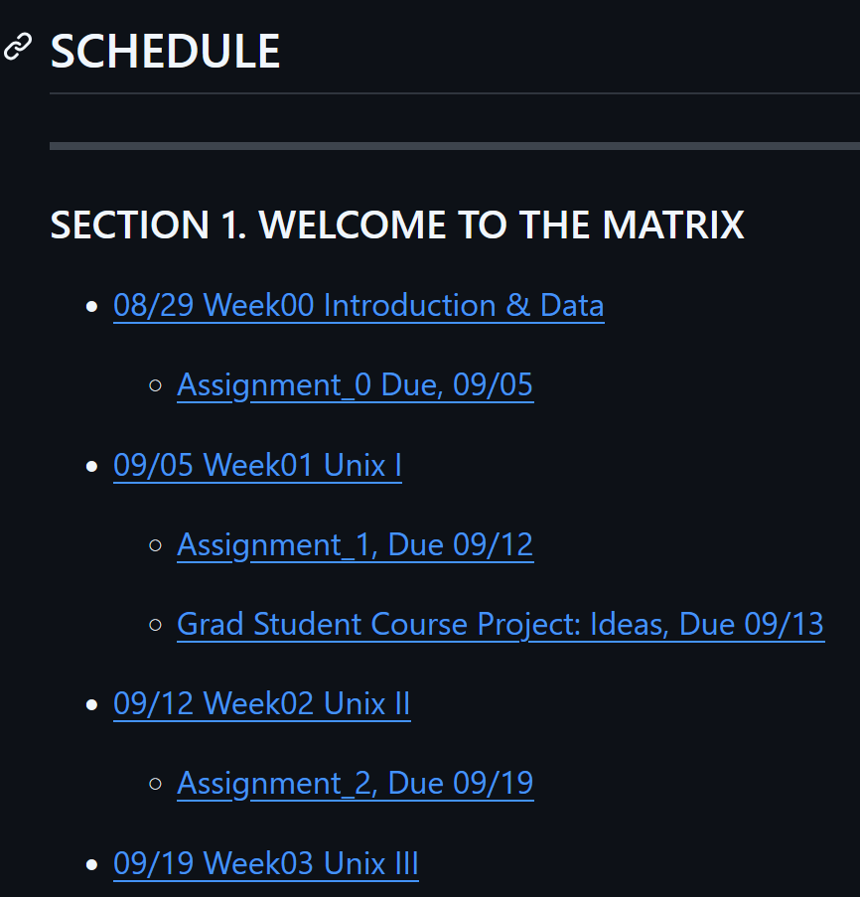
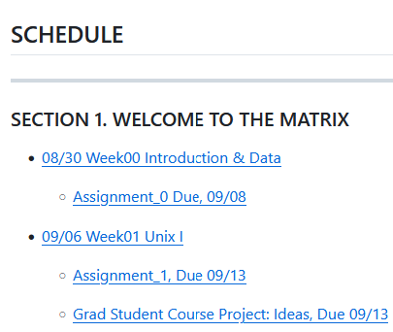
Assignments
Generally due each week
See the schedule in our classroom repo (link in canvas)
Scripts will be submitted through GitHub
Question-answer based work will be conducted with MS Forms “quizes”

Slide 13
Final Project (Graduate Students)
Automate the processing and analysis of your data
Follow guide on How to Organize Biological Data
Document work on GitHub
Report written in LaTeX or MarkDown
State problem/challenge
Describe strategy to solve
Describe how code works
10 min presentation during Final Exam Period (PhD students)
Wk 3: Project idea
Wk 5: Plan/Outline
Wk 6: GitHub Repo
Wk 7: Commit working function
Wk 8: Commit 2 working functions w data input and output
Wk 11: Draft/ progress report
Wk 14: Final report, Working code and data on GitHub
Final Exam: Oral pres (MARB 6360)

Slide 14
Questions?

Slide 15
Biological Data
Lecture 0.1
BIOL 4590, BIOL 5590
Dr. Chris Bird

Slide 16
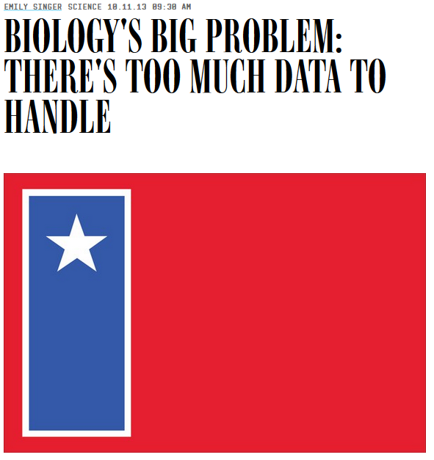
Big Data Biology
Massive amounts of data
Associated tools, processes, procedures
Volume, velocity, acceleration
Goal is to tame the data
Examples: DNA, climate, weather, remote sensing, GIS, all “omics”, populations
..and not enough biologists with the motivation, interest, and/or skill to address the issue

Slide 17
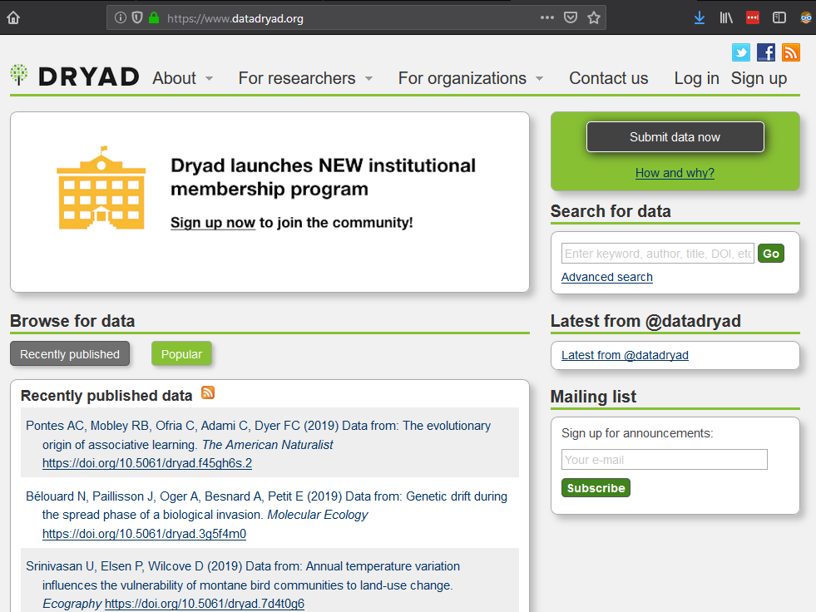
Repositories for Data Big and Small
Data associated with scientific papers should be published
Owned by the people
Should be freely available
Promotes acceleration of knowledge generation
All Types of Data
www.datadryad.com
DNA & Proteins
https://www.ncbi.nlm.nih.gov/
GIS
https://data.usgs.gov/datacatalog/#fq=dataType%3A(collection%20OR%20non-collection)&q=*%3A*
Oceanographic
https://data.noaa.gov/datasetsearch/
Too many to list

Slide 18
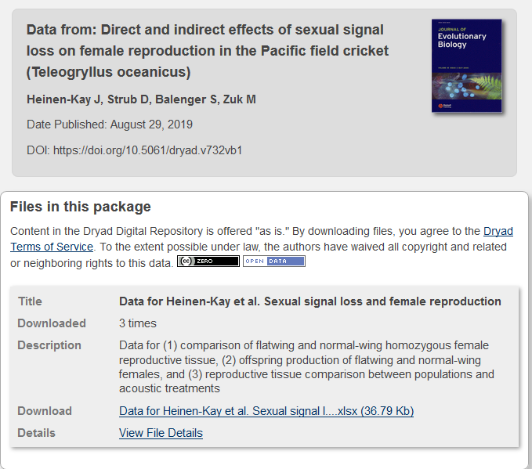
Let’s Explore a Data Set Published in Dryad
www.datadryad.org
Find Data from:
Direct and indirect effects of sexual signal loss on female reproduction in the Pacific field cricket (Teleogryllus oceanicus)
Download the data and view it in MS Excel
It is important to open files, look at data, and understand how it is organized

Slide 19
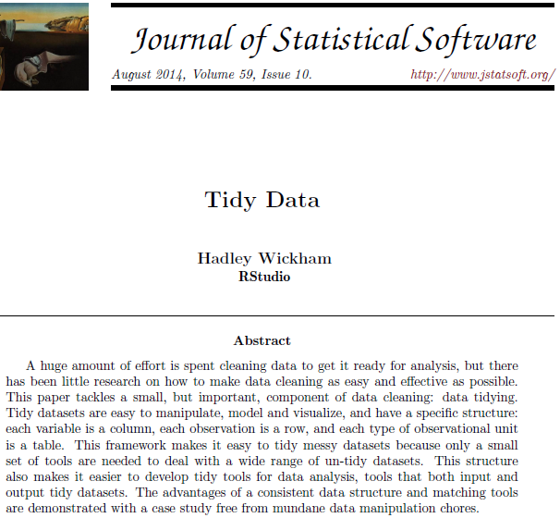

Tidy Data (Wickham 2014)
Each row is the “smallest unit of observation”
Ex: an individual fish
Each column is a variable or dimension of information about the units of observation
Ex: somatic mass

Slide 20
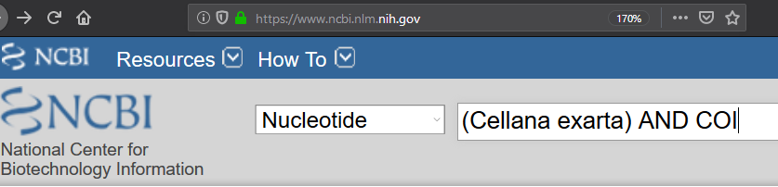
Common Data Formats & Structures are Not Always Tidy
https://www.ncbi.nlm.nih.gov/
Conduct the following search

Slide 21
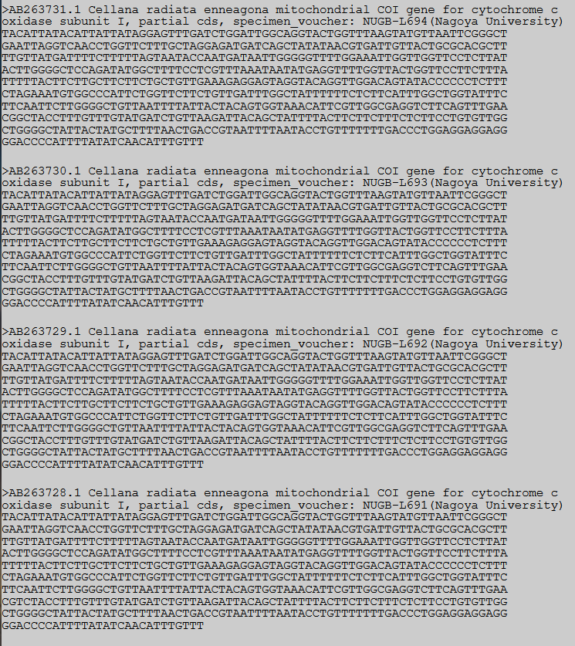
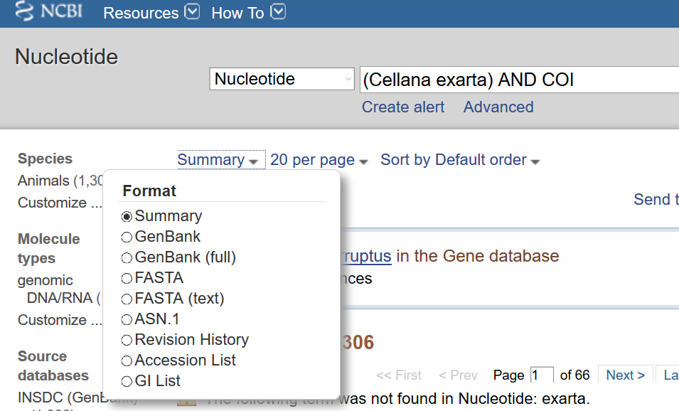
GenBank Supports Several Formats, None Are Tidy
https://www.ncbi.nlm.nih.gov/
Switch to FASTA (text)

Slide 22
Common DNA Data Format
https://www.ncbi.nlm.nih.gov/
Switch to FASTA (text)
Wikipedia is an excellent resource for describing data formats
FASTA Format
DNA
Lines beginning with `>` contain the ID of the unit of observation
Lines that don’t being with `>` contain information, each character (nucleotide) is a dimension of the unit of observation

Slide 23
Data Formats
I will emphasize Tidy format
Many fields of Biology have their own particular and peculiar data formats
There are tools available for handing and converting among data formats
Some data formats are intimidating, at first
There will exist published descriptions of these
Duckduckgo: sam specification
This is a common “big data” format for next generation sequencer data
Take a deep breath, it’s not as intimidating as it initially seems

Slide 24
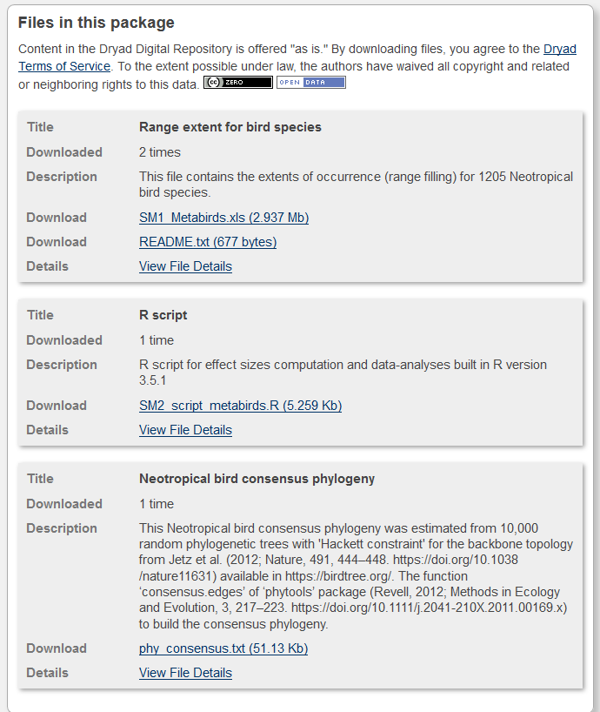
Repositories Can Include Scripts for Processing, Analyzing, & Visualizing Data
www.datadryad.com
Find Data from:
Meta‐analyzing the likely cross‐species responses to climate change
Explore the files
*.xls, *.txt,
The extension indicates file format NOT data format
R script
R is a statistical computer language
This file will analyze the data exactly the way it was reported in the publication

Slide 25
Recall The Philosophy of Data Science
All data is digitized and stored in files
Data manipulations and analyses are documented in computer scripts that interface with data files and require no additional human intervention to complete analysis
Data & scripts are published with the report and openly accessible to all
Data Files
Publications & Reports
Computer Scripts

Slide 26


Slide 27
Building your Computational Toolset

Slide 28
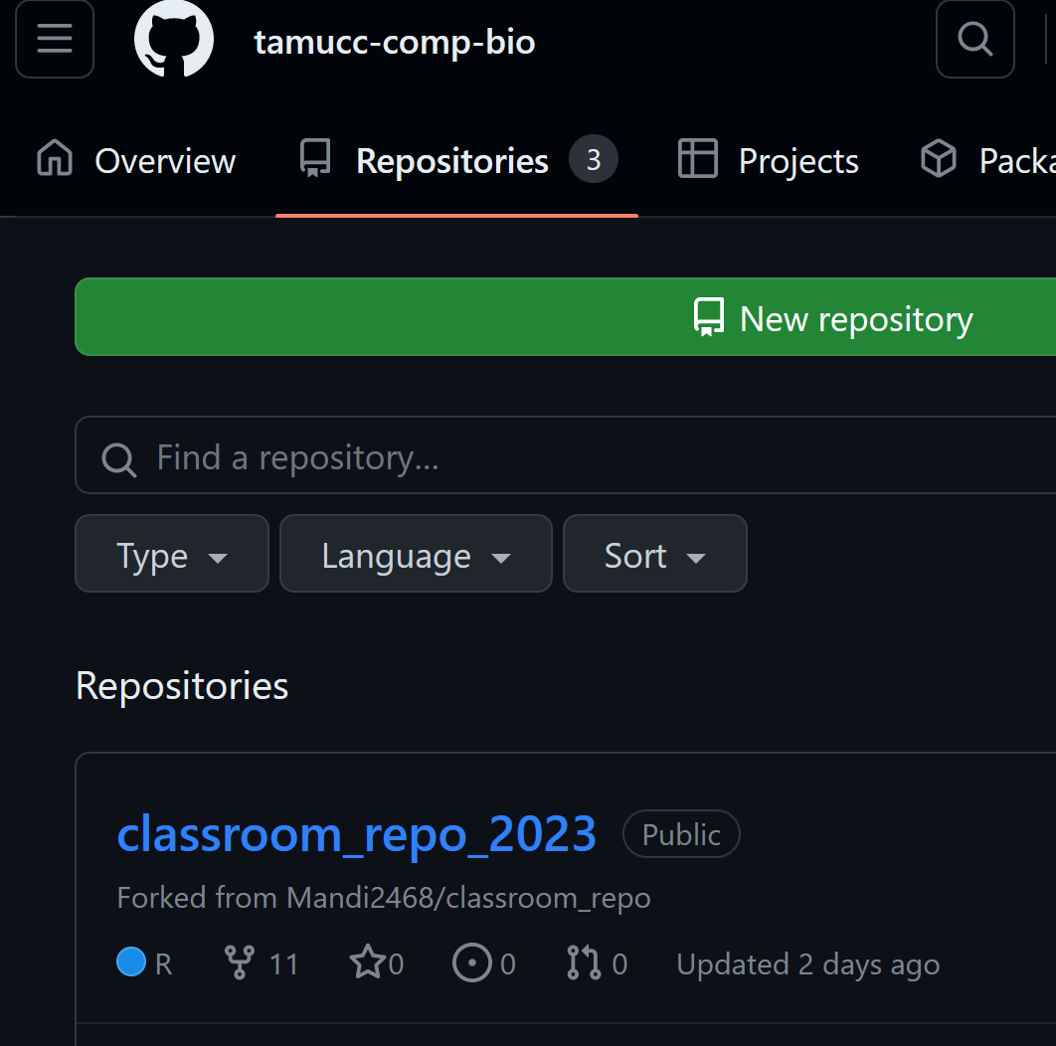
We Will Use GitHub – A Repository of Sorts
A company
Website is designed to aid in developing code, like an R script
It also serves as a repository for data, code, and scripts
Efficient mechanism to disseminate your code to users
Can also be used to organize a class
https://github.com/orgs/tamucc-comp-bio/repositories

Slide 29
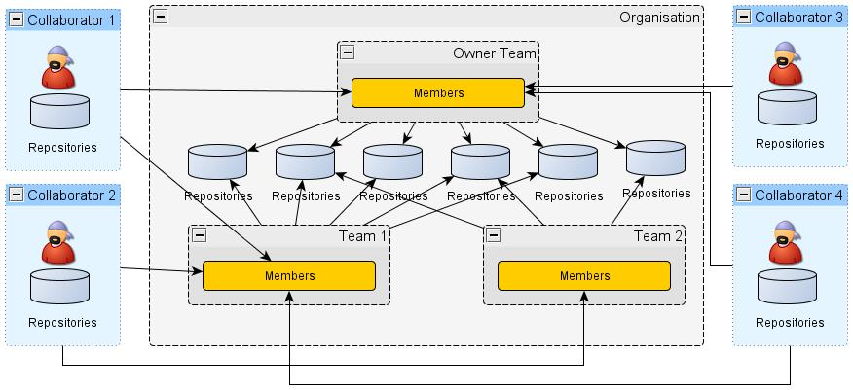
Conceptual Diagram of a GitHub Organization

Slide 30

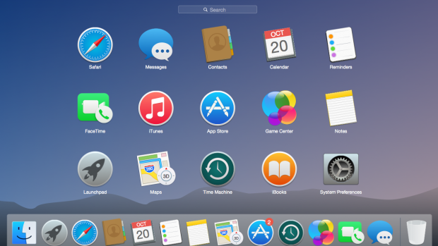
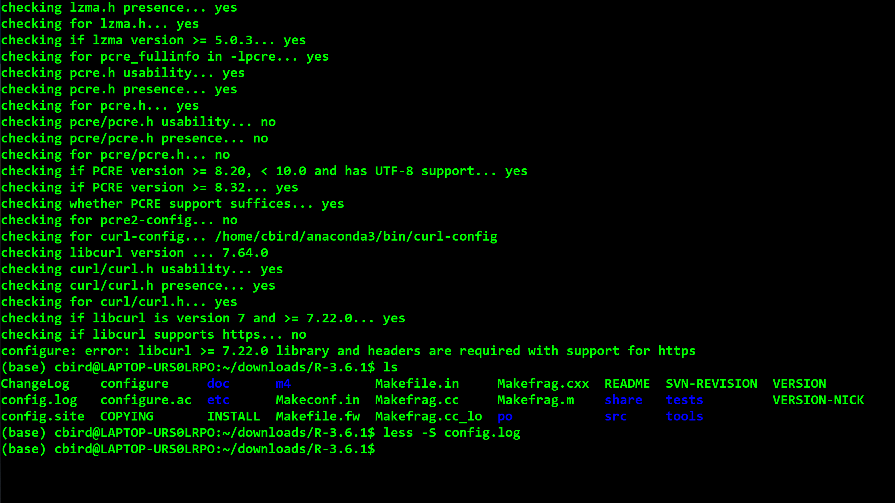
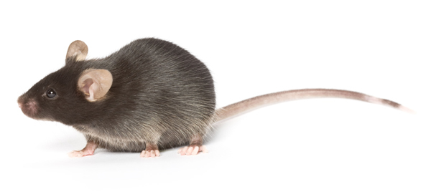
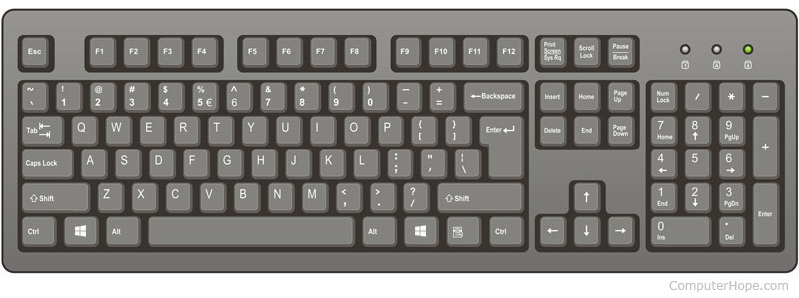
2 Primary Methods of Interfacing with Computers
Graphical User Interface (GUI)
Command-line Interface (CLI)

Slide 31
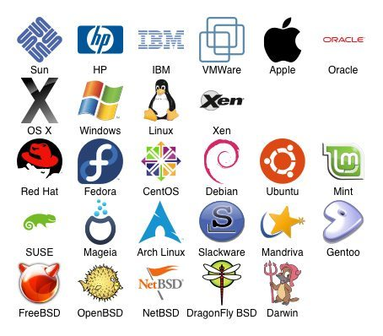
LINUX is a Free & Open Source Version of the UNIX Operating System with a CLI
An operating system is the primary interface between you and the computer
Open source is a decentralized development model where all aspects of a project are viewable and generally free to use
Linux is free
Supercomputers
Useful text manipulation tools

Slide 32
Coding Languages Use CLI (The Terminal)
BASH
Control computer terminal
Organize Files and Folders (Directories)
Manipulate text files
R
Statistical Computing
Python
Coding
Do anything with code
Git
Version control text files
Markdown
Typesetting
think MS Word deconstructed

Slide 33
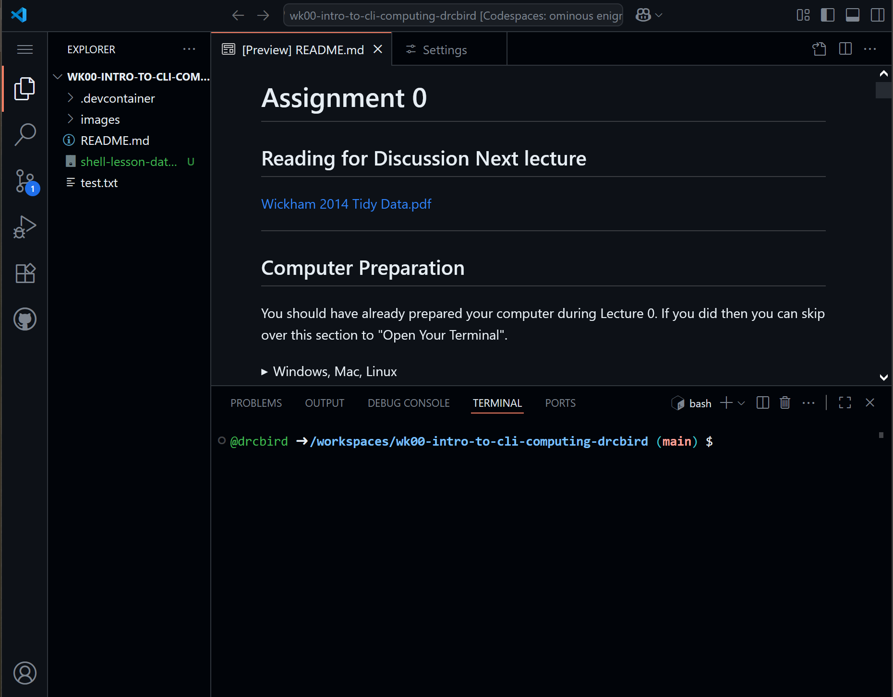
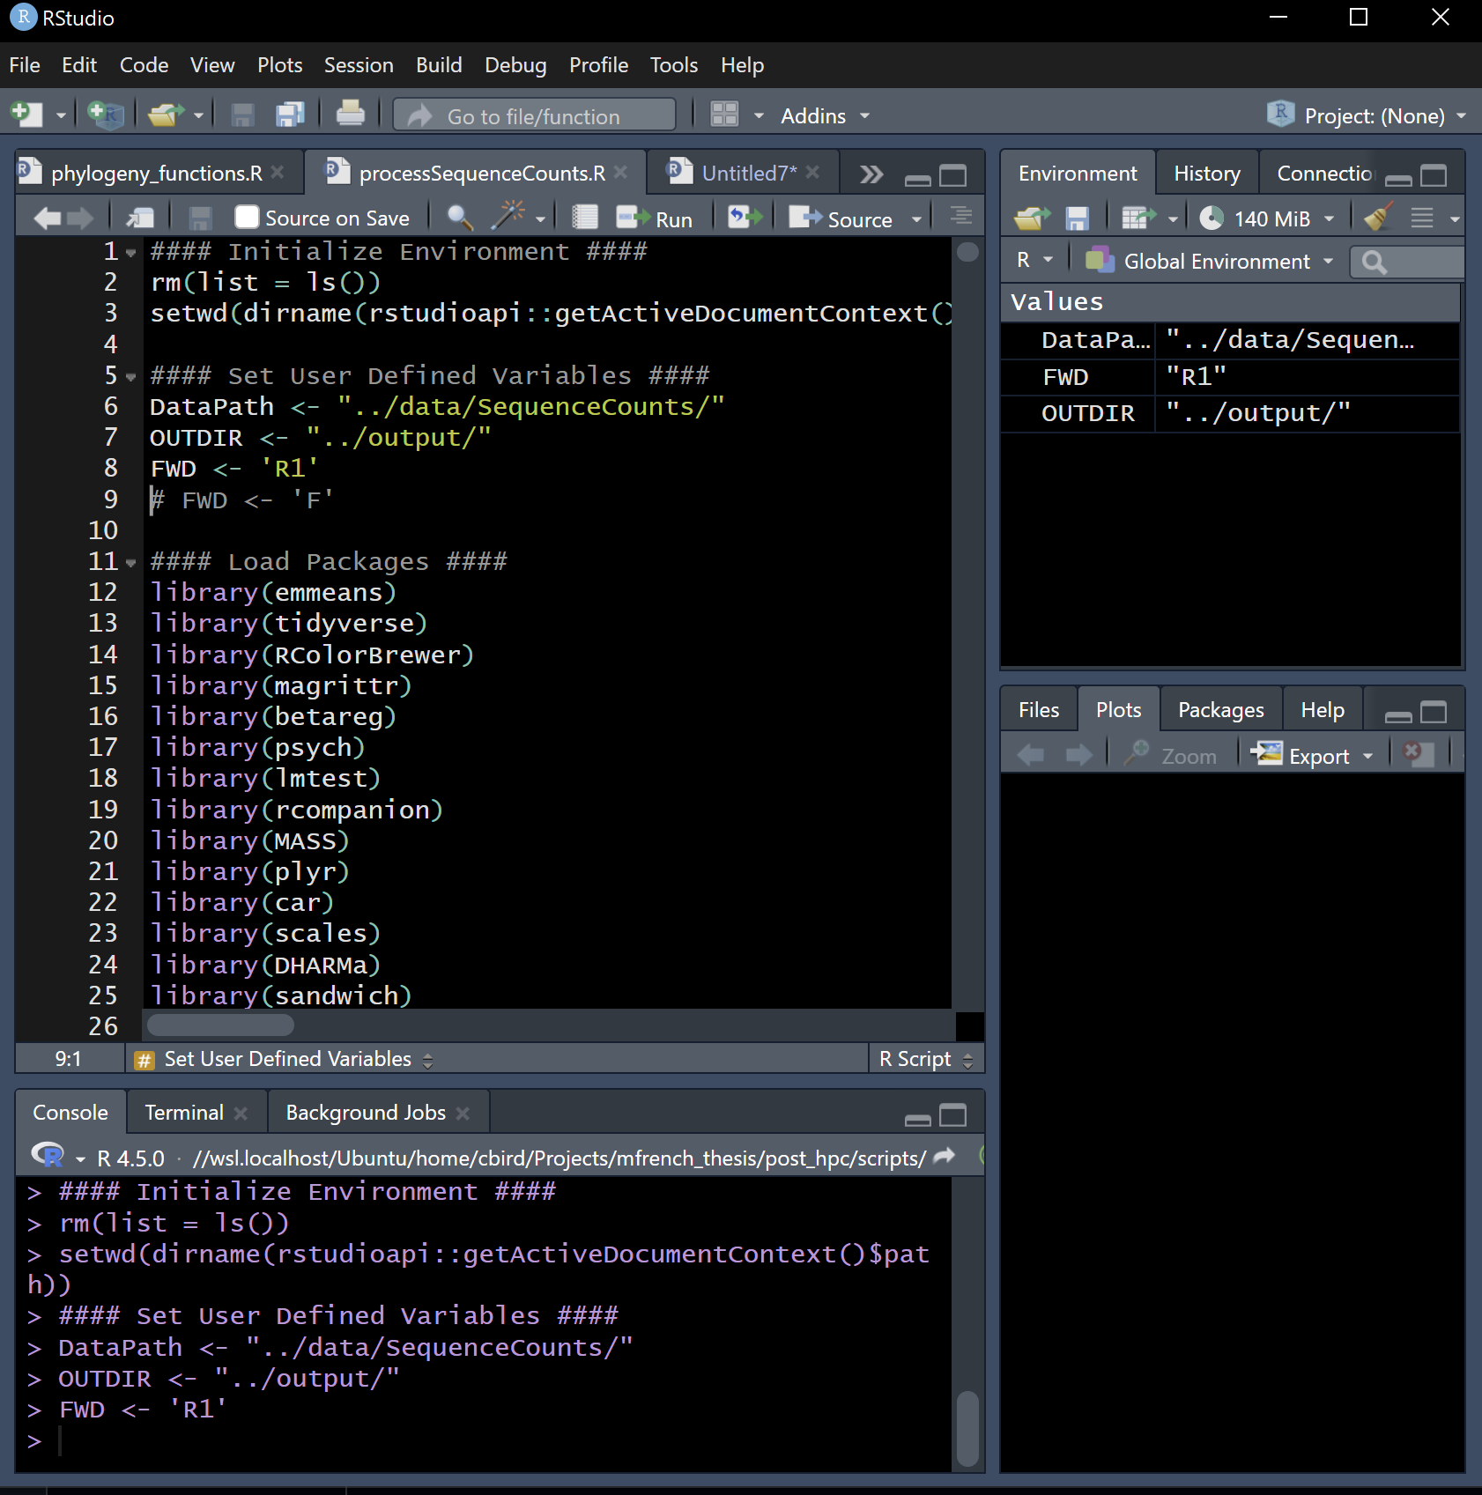
Integrated Development Environments (IDE)
GitHub Code Spaces (vscode)
Rstudio

Slide 34
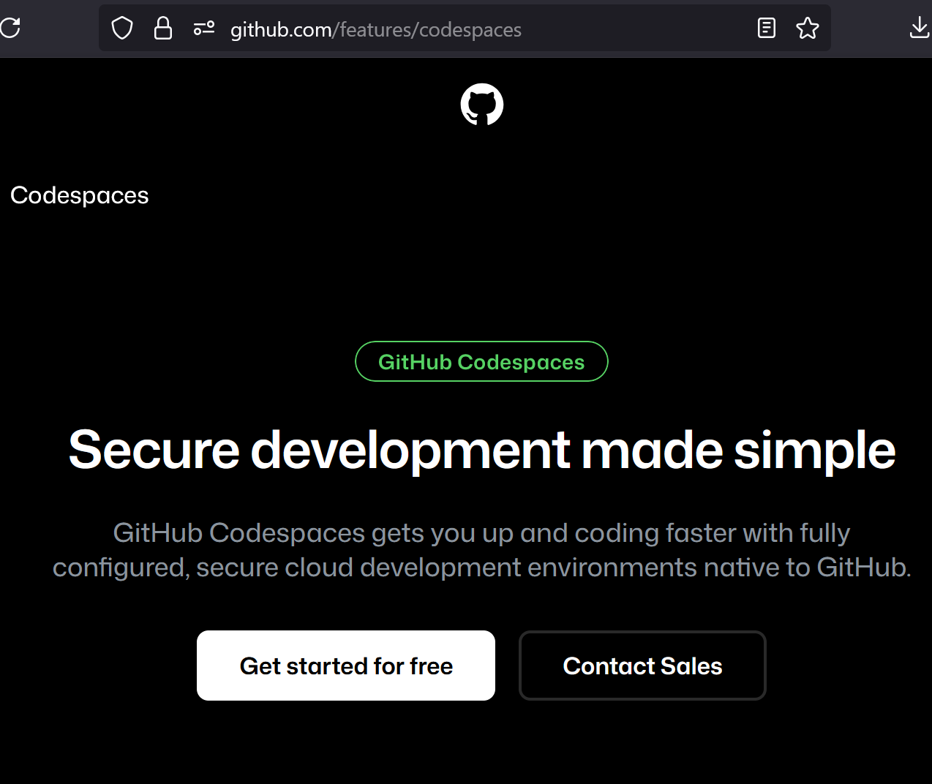
GitHub CodeSpaces
https://github.com/features/codespaces
Cloud-based development environment – Run VS Code in the cloud, accessible from any device.
Instant setup – Preconfigured environments with dependencies installed; start coding in seconds.
Integrated with GitHub – Open a repo directly in Codespaces with full GitHub integration.
Makes learning coding easier

Slide 35







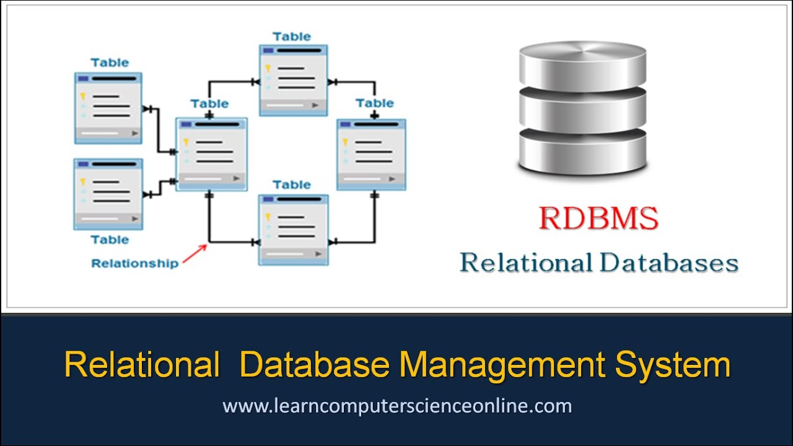

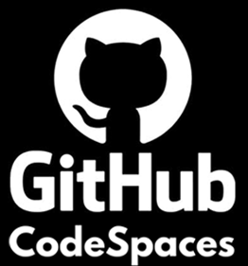
Goal: Teach You to Swim in “Open Water”

